Slide 1
Tools and Techniques for Data Science
Empowering Insights Through Data Analysis
Dr. Khalid Mahboob
(Ph.D. Computer Science & IT/ Educational Data Mining) NEDUET
Senior Lecturer
(College of Computer Science & Information Systems) IOBM

Slide 2
Introduction to Data Science
Definition of Data Science: Data science is an interdisciplinary field that uses scientific methods, algorithms, and systems to extract knowledge and insights from structured and unstructured data.
Importance of Data Science in Today's World: Data science plays a crucial role in various industries, including healthcare, finance, marketing, and technology, by enabling organizations to make data-driven decisions and gain competitive advantages.
Role of Data Scientists: Data scientists are responsible for collecting, cleaning, analyzing, and interpreting data to uncover patterns, trends, and insights that drive business growth and innovation.

Slide 3
Why Data Science?
Data is the oil of the modern age. With the proper tools, technologies, and algorithms, we can leverage data to create a unique competitive edge.
Data Science, with its sophisticated machine learning techniques, serves as a powerful shield against fraud, providing a reassuring layer of security.
It helps you avoid severe financial losses.
Enables the development of intelligent machines.
You may use sentiment analysis to determine your customers’ brand loyalty. This helps you to make better and quicker choices.
It enables you to propose the product to the relevant consumer to grow your company.

Slide 4
What is Data in Data Science?
Data is the foundation of data science. Data is the systematic record of specified characters, quantities, or symbols on which operations are performed by a computer, which may be stored and transmitted. It is a compilation of data to be utilized for a particular purpose, such as a survey or an analysis. When structured, data may be referred to as information. The source (original and secondary data) is also an essential consideration.
Data comes in many shapes and forms but can generally be considered the result of some random experiment - an experiment whose outcome cannot be determined in advance but whose workings are still subject to analysis. Data from a random experiment are often stored in a table or spreadsheet. A statistical convention to denote variables is frequently called features or columns and individual items (or units) as rows.

Slide 5

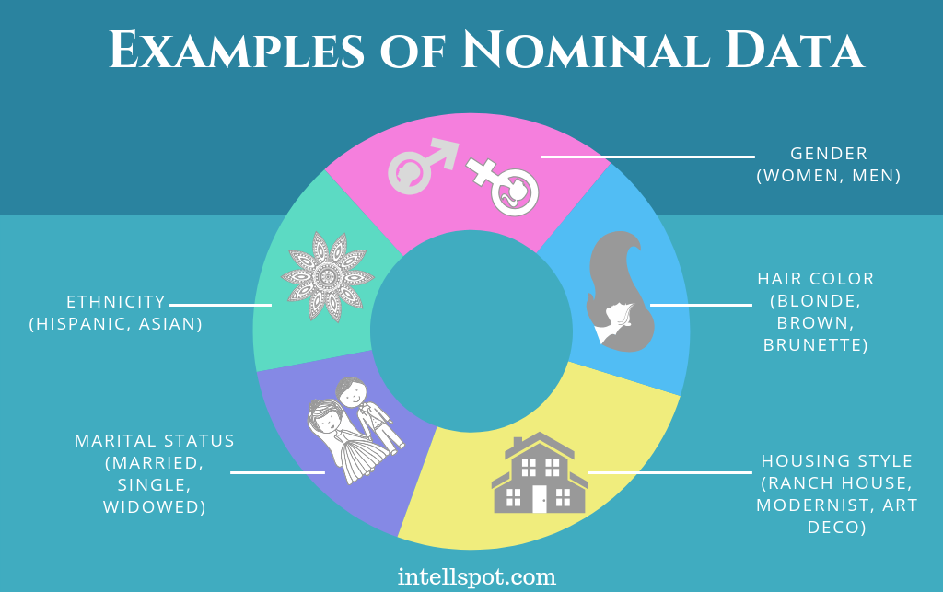
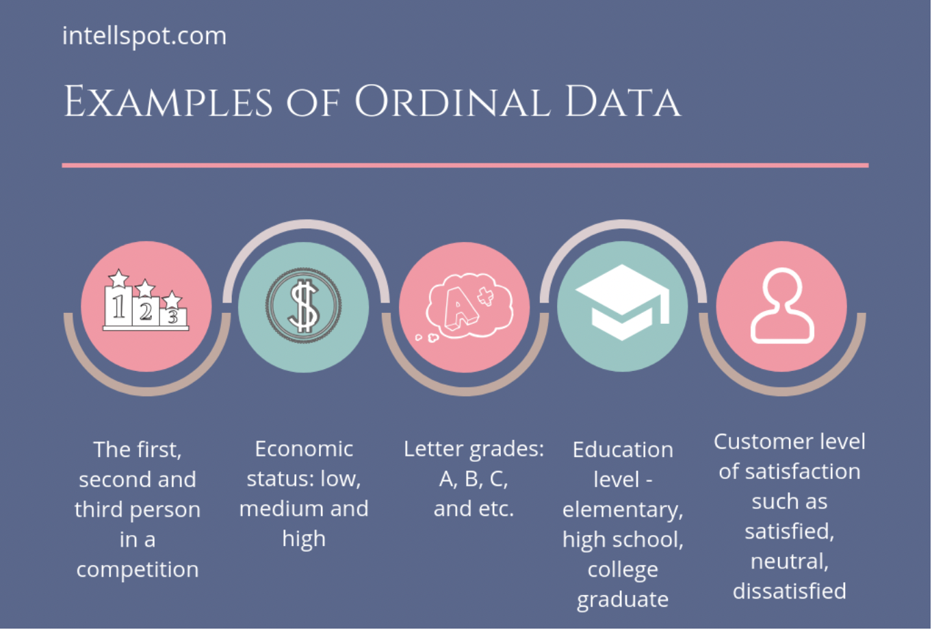
Types of Data: Qualitative Data
Nominal Data
Ordinal Data

Slide 6

Qualitative Data Collection Methods
Data Records − Utilizing data that already exists as a data source is the best technique for doing qualitative research. Similar to visiting a library, you may examine books and other reference materials to obtain data that can be utilized for research.
Interviews − Personal interviews are one of the most common ways to get deductive data for qualitative research. The interview may be casual and not have a set plan. It is often like a conversation. The interviewer or researcher gets the information straight from the interviewee.
Focus groups, consisting of 6 to 10 individuals engaging in a group discussion, are valuable qualitative research methods. The moderator's role is crucial in this setting, as they guide the conversation based on the focus questions, ensuring a productive and focused discussion.
Case Studies − Case studies are in-depth analyses of an individual or group, emphasizing the relationship between developmental characteristics and the environment.
Observation is a technique in which the researcher observes the object and takes down transcript notes to discover innate responses and reactions without prompting.

Slide 7
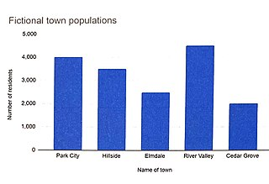
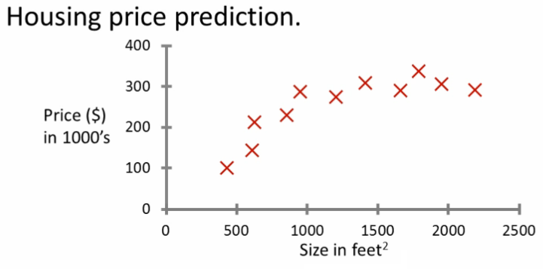
Types of Data: Quantitative Data
Discrete Data
Continuous Data

Slide 8
Quantitative Data Collection Methods
Surveys and Questionnaires − These types of research are good for getting detailed feedback from users and customers, especially about how people feel about a product, service, or experience.
Open-source Datasets − There are a lot of public datasets that can be found online and analyzed for free. Researchers sometimes look at data that has already been collected and try to figure out what it means in a way that fits their research project.
Experiments − A widely used research method, an experiment typically involves a control group and an experimental group. This setup allows for control over variables and the ability to modify conditions as required, making it a robust and flexible tool in scientific inquiry.
Sampling − When there are a lot of data points, it may not be possible to survey each person or data point. In this case, quantitative research is done with the help of sampling. Sampling is choosing a sample of data representative of the whole. The two types of sampling are Random sampling (also called probability sampling) and non-random sampling.

Slide 9
Key Concepts in Data Science
Data Collection: Gathering data from various sources, such as databases, APIs, web scraping, and sensors.
Data Cleaning and Preprocessing: Removing inconsistencies, handling missing values, and transforming data into a usable format.
Exploratory Data Analysis (EDA): Investigating the characteristics of the data through statistical summaries and visualizations to identify patterns and relationships.
Feature Engineering: Creating new features or transforming existing features to improve the performance of machine learning models.

Slide 10
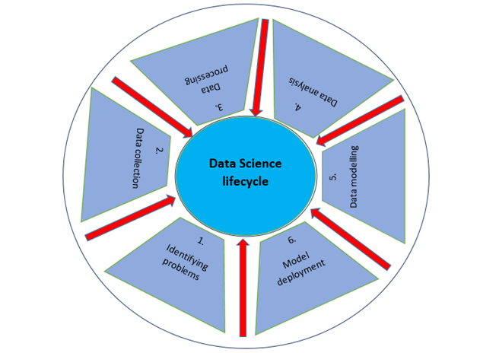
Data Science Lifecycle

Slide 11
Tools for Data Collection
Python Libraries: Pandas for data manipulation and analysis, BeautifulSoup for web scraping.
Web Scraping Tools: Scrapy for large-scale web crawling and Octoparse for visual web scraping.
APIs: Accessing data from social media platforms (e.g., Twitter API) and web services (e.g., Google API).
Data Acquisition Platforms: Kaggle and UCI Machine Learning Repository for accessing publicly available datasets.

Slide 12
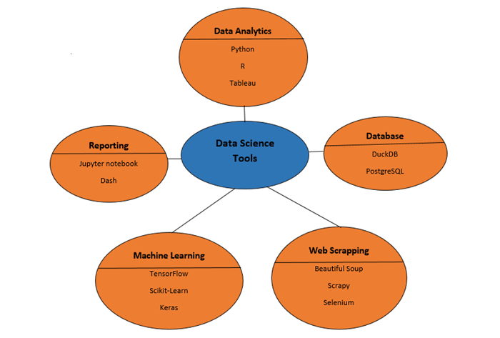
Data Science - Tools in Demand

Slide 13
Techniques for Data Cleaning
Handling Missing Values: Strategies include imputation techniques such as mean imputation, median imputation, and forward-fill/back-fill.
Data Imputation Techniques: Using algorithms such as K-nearest neighbors (KNN) imputation and interpolation methods.
Outlier Detection and Treatment: Identifying and removing outliers using statistical methods or machine learning algorithms.
Data Standardization and Normalization: Scaling features with a mean of 0 and a standard deviation of 1 or scaling features to a fixed range.

Slide 14
Exploratory Data Analysis (EDA)
Statistical Summary: Descriptive statistics such as mean, median, mode, standard deviation, and quartiles.
Data Visualization Techniques: Histograms, boxplots, scatter plots, pair plots, and heatmaps.
Correlation Analysis: Calculating correlation coefficients to measure the strength and direction of relationships between variables.
Dimensionality Reduction Techniques: Principal Component Analysis (PCA) and t-distributed Stochastic Neighbor Embedding (t-SNE) for visualizing high-dimensional data in lower dimensions.

Slide 15
Useful Data Science Resources
Kaggle (www.kaggle.com)
UCI Machine Learning Repository (https://archive.ics.uci.edu/)
Data.gov (www.data.gov)
Google Dataset Search (https://datasetsearch.research.google.com/)
AWS Open Data Registry (registry.opendata.aws)
Reddit's r/datasets (www.reddit.com/r/datasets)
World Bank Open Data (data.worldbank.org)
Data.gov.uk (data.gov.uk)
Microsoft Research Open Data (msropendata.com)
DataHub (datahub.io)

Slide 16
Machine Learning
Machine learning (ML) is an algorithm that lets software get more accurate at predicting what will happen in the future without being specifically programmed to do so. The basic idea behind machine learning is to make algorithms that can take data as input and use statistical analysis to predict an output while updating outputs as new data becomes available.
Machine learning is a part of artificial intelligence that uses algorithms to find patterns in data and then predict how those patterns will change in the future. This lets engineers use statistical analysis to look for patterns in the data.
Facebook, Twitter, Instagram, YouTube, and TikTok collect information about their users. Based on what you've done in the past, they can guess your interests and requirements and suggest products, services, or articles that fit your needs.
Machine learning is a set of tools and concepts used in data science, but they also appear in other fields. Data scientists often use machine learning in their work to help them get more information faster or figure out trends.

Slide 17
Machine Learning Algorithms
Supervised Learning: Regression algorithms (e.g., Linear Regression, Decision Trees) for predicting continuous numerical values and Classification algorithms (e.g., Logistic Regression, Random Forest) for predicting categorical labels.
Unsupervised Learning: Clustering algorithms (e.g., K-means clustering, Hierarchical clustering) for grouping similar data points and Dimensionality Reduction algorithms (e.g., PCA, t-SNE) for reducing the number of features while preserving important information.
Ensemble Methods: Techniques such as Random Forest, Gradient Boosting, and AdaBoost that combine multiple weak learners to improve model performance.
Deep Learning: Neural networks, including Convolutional Neural Networks (CNNs) for image recognition tasks and Recurrent Neural Networks (RNNs) for sequential data analysis.

Slide 18
Model Evaluation and Validation
Cross-Validation Techniques: K-Fold Cross-Validation and Stratified Cross-Validation for estimating model performance on unseen data.
Evaluation Metrics: Accuracy, Precision, Recall, F1-Score, ROC-AUC for classifcation models and Mean Absolute Error (MAE) for regression models.
Hyperparameter Tuning Techniques: Grid Search and Random Search for finding the optimal hyperparameters of machine learning models.

Slide 19
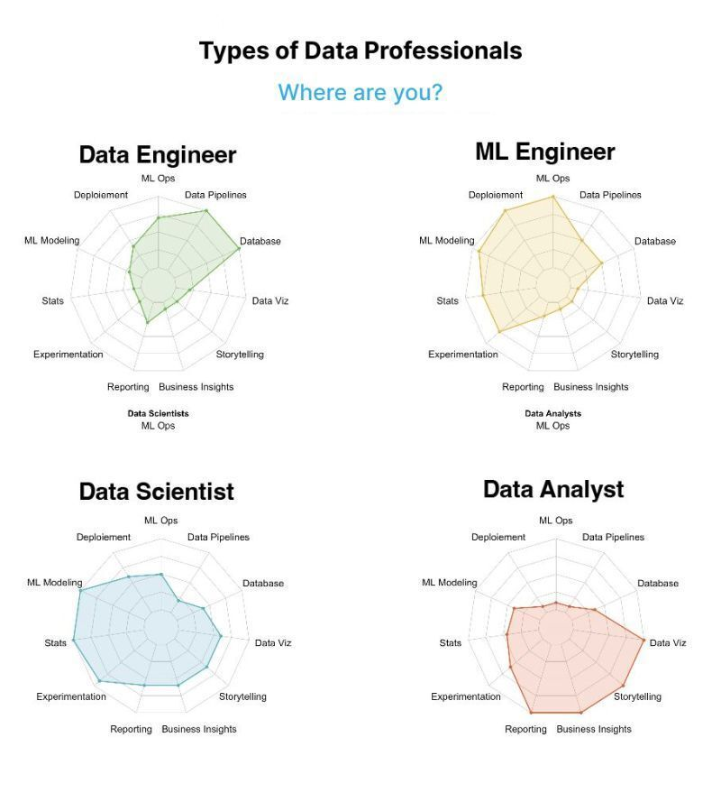
Data Science - Careers

Slide 20
Data Science - Careers
Data Engineer: Data engineers build and maintain the technology infrastructure for storing and processing data. They design databases, develop data pipelines, and ensure data is secure and accurate. They're skilled in programming languages like SQL, Hadoop, and Spark.
Machine Learning Engineer: Machine learning engineers focus on developing and implementing machine learning algorithms and models. They understand data analysis, statistical modeling, and programming. Their expertise lies in training and fine-tuning models for high accuracy and real-world applications.
Data Scientist: Data scientists are like data wizards. They combine statistics, machine learning, and programming to solve complex problems and create predictive models. They work with large datasets, use advanced algorithms, and find hidden patterns to make accurate predictions and drive business strategies.
Data Analyst: Data analysts are skilled at finding important information from raw data. They use tools like Excel, SQL, and data visualization software to analyze data and present their findings. Their goal is to uncover patterns and help make informed decisions.

Slide 21
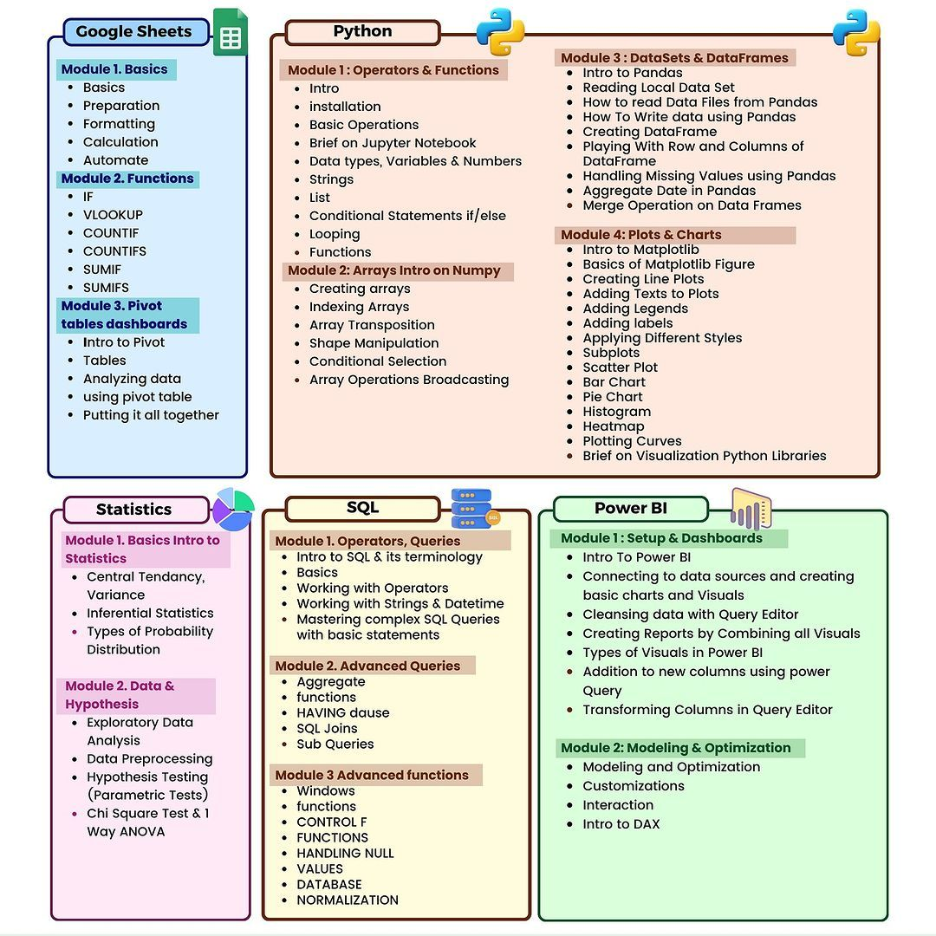
Data Analyst - Roadmap

Slide 22
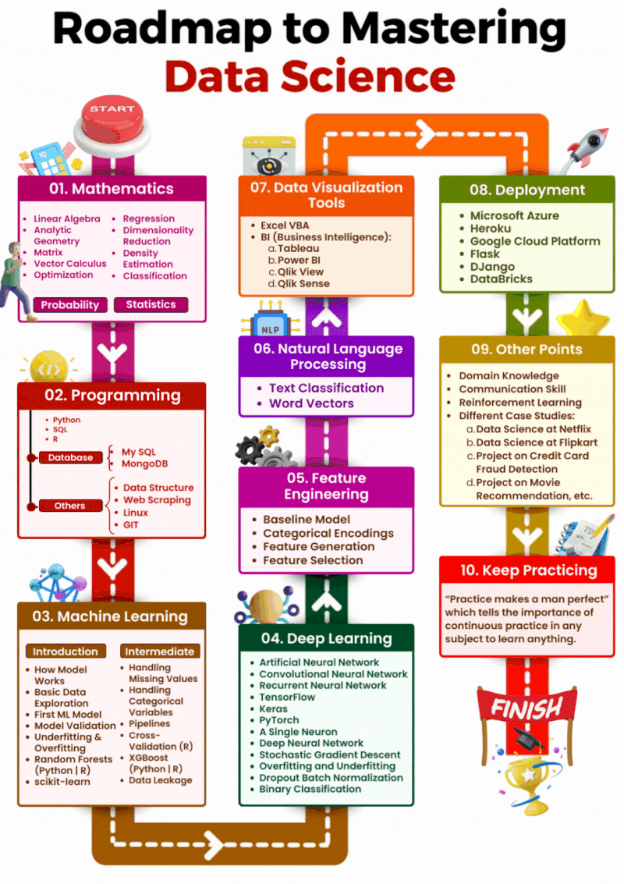

Slide 23
Thank You

